Slide 1



CAD ASSIGNMENT
CAD
UNIT-01
PRESENTATION
PRESENTED TO
Mr.Nikhil Sharma
PRESENTED BY
Ganesh Agrahari
All Topics of Unit one will be cover in this presentation
12-03-2024

Slide 2
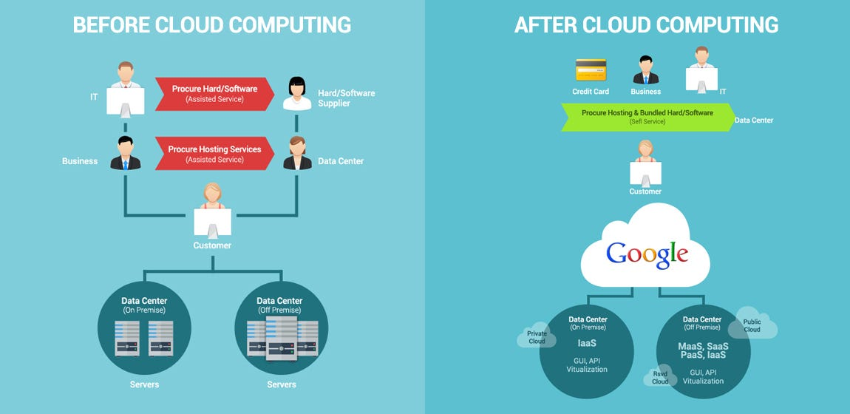
Before could computing:- Before the widespread adoption of cloud computing, computing resources were typically managed and hosted locally within an organization's own infrastructure. Here are some key characteristics of the computing landscape before the advent of cloud computing:
Before cloud computing:
On-Premises Infrastructure:
Organizations managed their own servers and data centers locally.
Capital Expenditure (CapEx):
Upfront capital investment was required for hardware and software.
Fixed Capacity:
Computing resources were fixed, leading to inefficiencies during low demand.
Limited Scalability:
Scaling infrastructure to handle increased workloads was slow and costly.
Inefficient Resource Utilization:
Servers often operated at low utilization rates.
Long Deployment Times:
Setting up new applications took time due to physical hardware provisioning.
High Maintenance Overhead:
Manual intervention was needed for routine maintenance tasks.

Slide 3
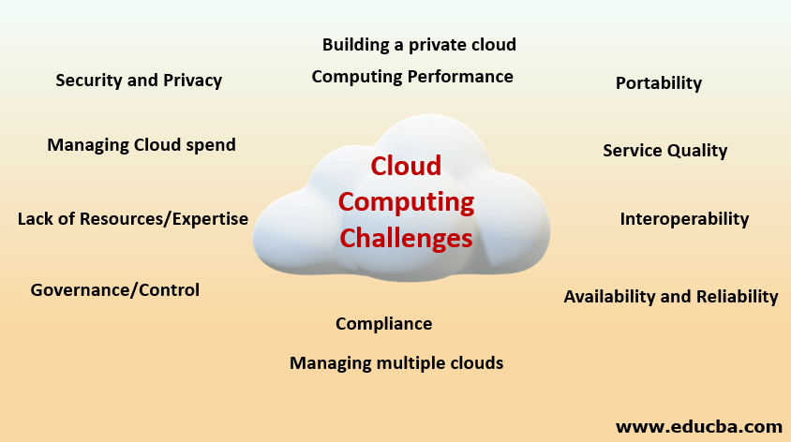
Challenges faced before cloud:-
Before the widespread adoption of cloud computing, organizations faced several challenges in managing their IT infrastructure:
Costly Infrastructure:
High upfront costs for purchasing and maintaining hardware and software.
Limited Scalability:
Difficulty in scaling resources to meet varying workloads and demands.
Inefficient Resource Utilization:
Low utilization rates of on-premises servers, leading to wasted capacity.
Long Deployment Cycles:
Time-consuming processes for setting up and deploying new applications.
Capital Expenditure Burden:
Capital expenditures required for infrastructure investment, often leading to financial strain.

Slide 4
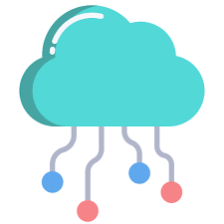
What is cloud computing:-
Cloud computing is a technology model that enables on-demand access to a shared pool of computing resources over the internet. Instead of owning and maintaining physical servers and infrastructure, users can access and use computing resources such as servers, storage, databases, networking, software, and analytics through cloud service providers High upfront costs for purchasing and maintaining hardware and software.
Key characteristics of cloud computing include:
On-Demand Self-Service:
Users can provision and manage computing resources as needed without requiring human intervention from the service provider.
Broad Network Access:
Cloud services are accessible over the internet from various devices, such as laptops, smartphones, and tablets.
Resource Pooling:
Computing resources are pooled and shared among multiple users, allowing for efficient utilization and optimization of resources.
Rapid Elasticity:
Resources can be quickly scaled up or down based on demand, providing flexibility and cost efficiency.
Measured Service : Usage of resources is monitored, controlled, and billed according to a pay-as-you-go or subscription model, promoting cost transparency.

Slide 5
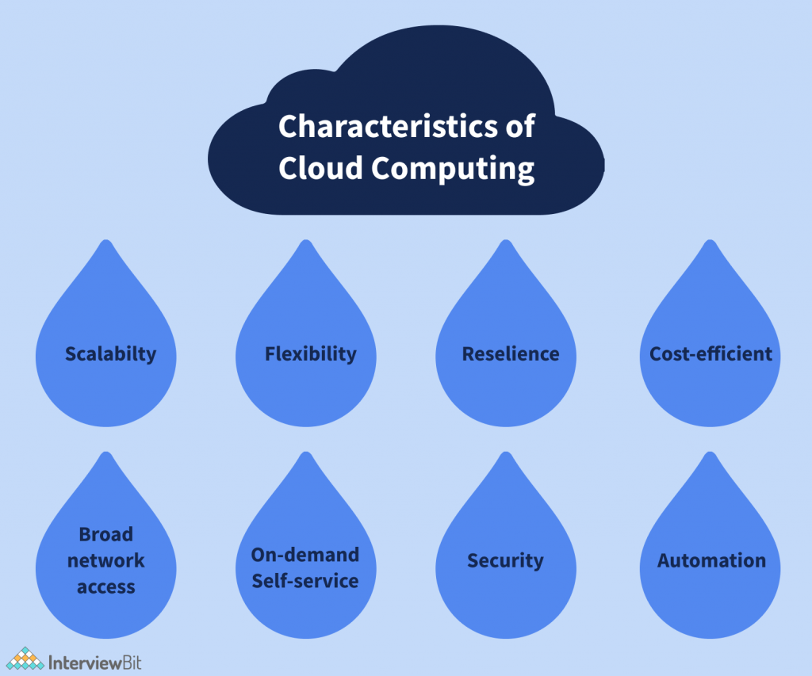
Characteristics of cloud computing:-
Cloud computing is characterized by several key features that distinguish it from traditional on-premises IT models. These characteristics highlight the flexibility, scalability, and efficiency that cloud services offer:Key characteristics of cloud computing include:
On-Demand Self-Service:
Users can provision and manage computing resources, such as servers, storage, and applications, without requiring human intervention from the service provider.
Broad Network Access:
Cloud services are accessible over the internet from a variety of devices, promoting universal accessibility.
Resource Pooling:
Computing resources are pooled and shared among multiple users, allowing for efficient use of resources. Resources are dynamically assigned based on demand.
Rapid Elasticity:
Cloud resources can be quickly scaled up or down to accommodate changes in demand. This elasticity enables users to pay for only the resources they consume.
Measured Service:
Resource usage is monitored, controlled, and reported, allowing users to be billed based on their actual consumption. This pay-as-you-go model provides cost transparency.

Slide 6
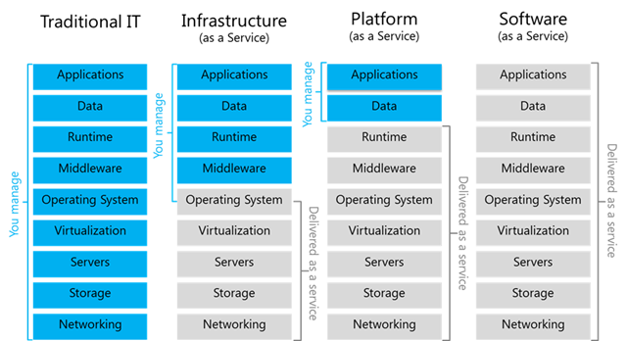
Cloud Service Models:-
Cloud service models define the type of services and resources offered by cloud providers. There are three primary cloud service models:
Infrastructure as a Service (IaaS):
In IaaS, cloud providers offer virtualized computing resources over the internet. Users can rent virtual machines, storage, and networking components on a pay-as-you-go basis. This model allows for greater flexibility and control over the underlying infrastructure, as users are responsible for managing their operating systems, applications, and data. Examples of IaaS providers include Amazon Web Services (AWS) EC2, Microsoft Azure Virtual Machines, and Google Compute Engine.
Platform as a Service (PaaS):
PaaS provides a platform that allows users to develop, deploy, and manage applications without dealing with the complexities of underlying infrastructure. Cloud providers offer a ready-to-use development platform, including tools, libraries, and services. Users focus on application development and deployment, while the platform handles aspects such as scalability, patching, and runtime environments. Examples of PaaS services include Google App Engine, Microsoft Azure App Services, and Heroku.
Software as a Service (SaaS):
SaaS delivers software applications over the internet on a subscription basis. Users can access the software through a web browser without the need for local installation or management. The software is hosted and maintained by the cloud provider, who handles tasks like updates, security, and maintenance. Examples of SaaS applications include Google Workspace (formerly G Suite), Microsoft 365, Salesforce, and Dropbox.

Slide 7
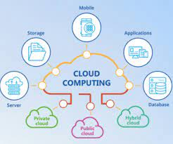
Examples of Cloud Services:-
here are brief examples of cloud services across different models:
Infrastructure as a Service (IaaS):
Amazon EC2
Microsoft Azure Virtual Machines
Google Compute Engine
Platform as a Service (PaaS):
Heroku
Google App Engine
Microsoft Azure App Services
Software as a Service (SaaS):
Microsoft 365
Salesforce
Google Workspace
Dropbox

Slide 8
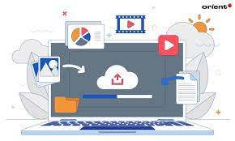
Choices when building cloud application:-
When building a cloud application, developers and organizations have various choices to make based on their specific needs, preferences, and requirements. Here are key decisions to consider:
1. Cloud Service Model:
Choose the appropriate service model (IaaS, PaaS, or SaaS) based on the level of control and abstraction desired.
Determine the trade-offs between control and ease of management.
2. Cloud Deployment Model:
Decide on the deployment model, whether it's public, private, hybrid, or multi-cloud.
Evaluate factors such as data sensitivity, compliance, and scalability.
3. Programming Language and Framework:
Select the programming language and framework that best suits the application's requirements.
Consider the compatibility with cloud services and ease of development.
4. Database and Storage:
Choose the appropriate database type (relational, NoSQL) and storage solutions.
Consider factors such as scalability, performance, and data consistency.
5. Compute Resources:
Determine the type and size of virtual machines or containers needed.
Consider serverless options for event-driven applications.
6. Networking and Security:
Design the network architecture, including subnets, security groups, and VPN connections.
Implement security measures such as encryption, access controls, and firewalls.

Slide 9
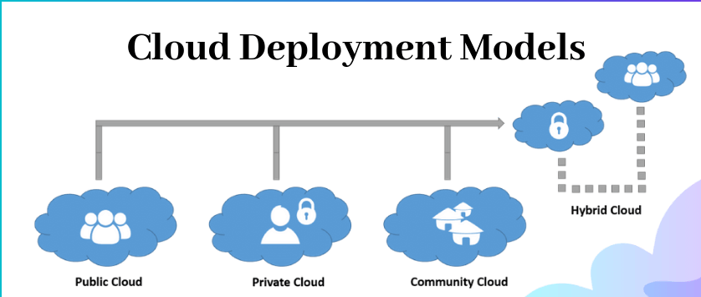
Cloud deployment models:-
the primary cloud deployment models are:
Public Cloud:
Third-party providers offer shared resources.
Scalable, pay-as-you-go model.
Ideal for startups, variable workloads, and development/testing.
Private Cloud:
Exclusive use by a single organization.
Offers control, customization, and security.
Suitable for enterprises with specific compliance needs and sensitive data.
Hybrid Cloud:
Combination of public and private cloud.
Provides flexibility and unified management.
Useful for applications with varying workloads and data portability

Slide 10
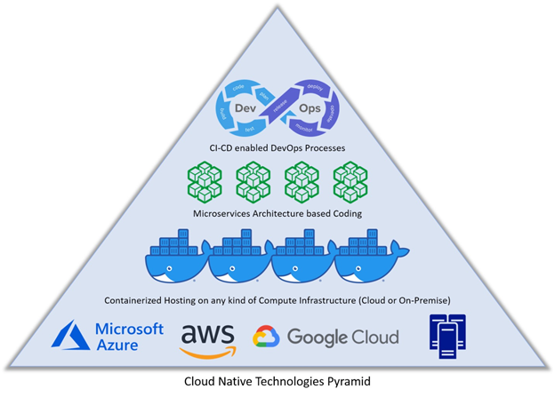
Cloud Native Applications:-
A cloud-native application is an application that is specifically designed and built to operate optimally in cloud environments. These applications take full advantage of cloud computing principles and often follow certain architectural patterns and best practices. Key characteristics of cloud-native applications include:
Microservices Architecture:
Cloud-native applications are often built using a microservices architectural style, where the application is composed of loosely coupled, independently deployable services.
Containers and Orchestration:
They leverage containerization technologies, such as Docker, and container orchestration platforms, like Kubernetes, to ensure consistent deployment and scaling across different environments.
DevOps Practices:
Cloud-native development embraces DevOps practices, fostering collaboration between development and operations teams. Continuous integration, continuous delivery (CI/CD), and automated testing are common practices.
Scalability and Elasticity:
Cloud-native applications are designed to scale horizontally, allowing them to handle varying workloads. They take advantage of cloud provider services for automatic scaling based on demand.
Resilience and Fault Tolerance:
They are built with resilience in mind, handling failures gracefully. This often involves redundancy, load balancing, and the ability to recover quickly from failures.
API-First Design:
Cloud-native applications often follow an API-first design approach, providing well-defined and documented APIs that enable easy integration with other services and applications.

Slide 11
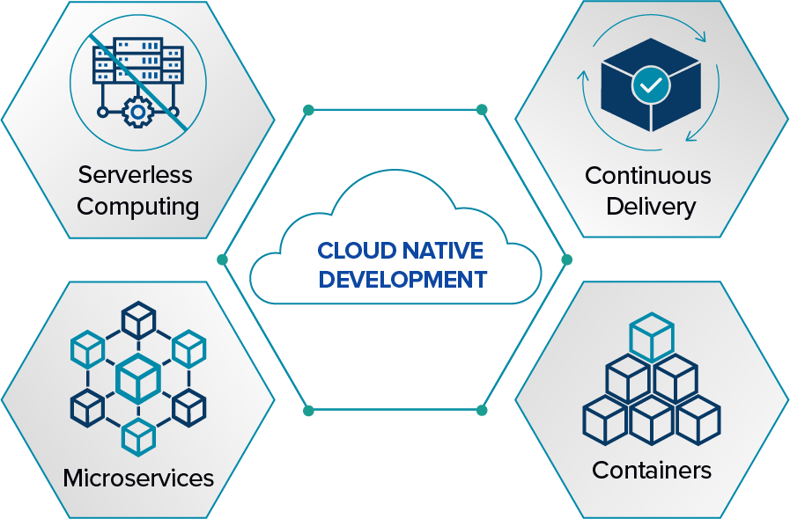
Cloud Native Applications Development Method:-
Cloud-native application development involves a methodology that aligns with the principles of cloud computing to maximize efficiency, scalability, and agility. Key components of the cloud-native development method include:
Microservices Architecture:
Decompose applications into small, independent services for easier development, deployment, and scalability.
Containers and Orchestration:
Utilize containerization (e.g., Docker) and orchestration tools (e.g., Kubernetes) for consistent and scalable deployment across different environments.
DevOps Practices:
Embrace DevOps culture, fostering collaboration between development and operations teams. Implement continuous integration, continuous delivery (CI/CD), and automated testing.
Infrastructure as Code (IaC):
Define and manage infrastructure using code for consistent, automated provisioning, reducing manual configuration errors.
API-First Design:
Prioritize designing applications with well-defined APIs, facilitating integration and interoperability.

Slide 12
